Slide 1

Furniture
Application

Slide 2
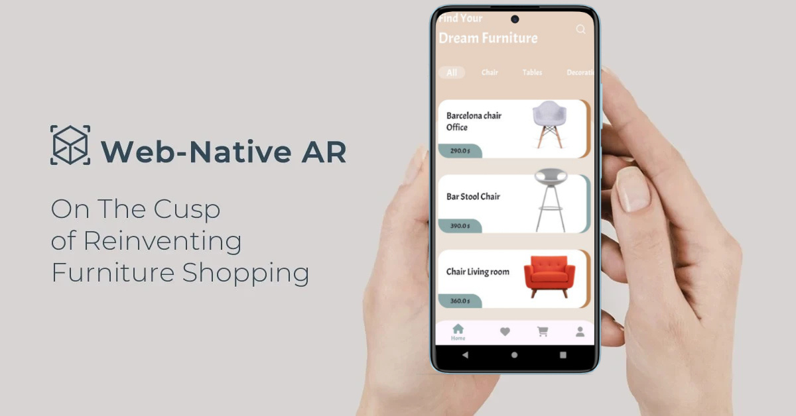

Introduction
Our Furniture App offers a smooth shopping experience with key features such as Firebase-based sign-up/login, categorized product browsing (Decoration, Chairs, Tables), detailed product pages, and a powerful search function. Users can easily add items to their cart or favorites, adjust quantities, and complete purchases seamlessly—all from their mobile device.

Slide 3

TEAM
Nada Kenawy
Rahma sherif
Nada Amr
Mariam Mohamed
Mayada Mohammed
Hedaia Hesham
Supervisor:
Amr Adel

Slide 4

problem
finding the right furniture that matches personal taste can be a long, exhausting process. Consumers often spend time and effort traveling to multiple stores, like in Egypt where many travel to cities like Damietta. Even after visiting many shops, they may not find what they’re looking for.
Solution
Our E-Commerce Furniture App allows users to explore a wide range of products with detailed information, all from the comfort of their homes. It saves time, effort, and ensures a hassle-free shopping experience.

Slide 5

WHY..!?
Vision
To become a leading furniture shopping platform, providing easy access to high-quality products through a seamless mobile experience, and revolutionizing how people shop for furniture in the e-commerce era.
Mission
To deliver a modern, efficient, and user-friendly e-commerce solution for furniture shopping, meeting the demand for convenient purchases with categorized products, detailed information, and a smooth checkout process.

Slide 6


Technology Used
Flutter
Here are the Technologies used in our application:
Dart
Firebase
Cubit(bloc)

Slide 7

FEATURES
User-Friendly Interface.
Firebase Authentication.
Categorized Product Browsing
Detailed Product Information
Favorites Feature
Seamless Checkout Process
Search Functionality

Slide 8
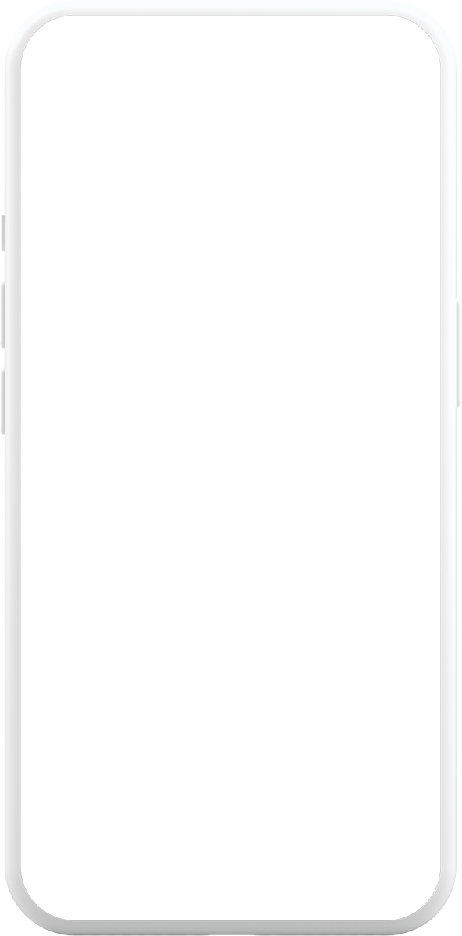
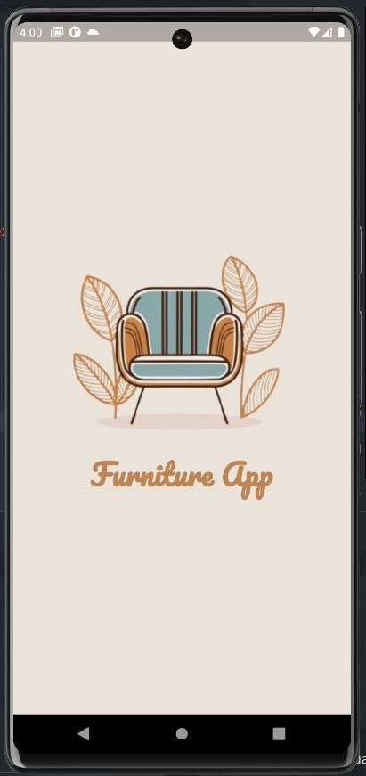
User-Friendly Interface.
Intuitive design for easy navigation.

Slide 9
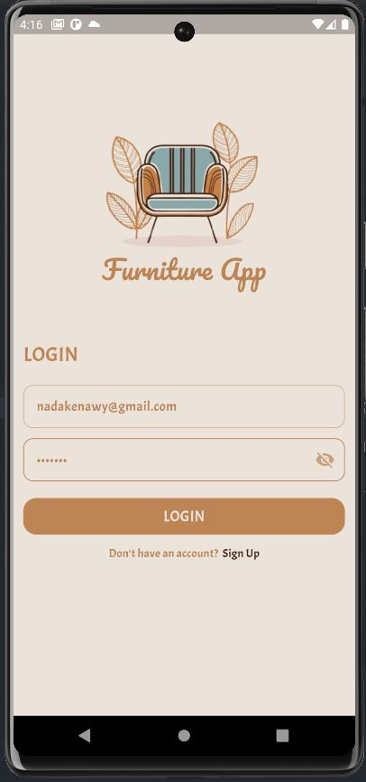
Firebase Authentication
Secure sign-up and login process

Slide 10
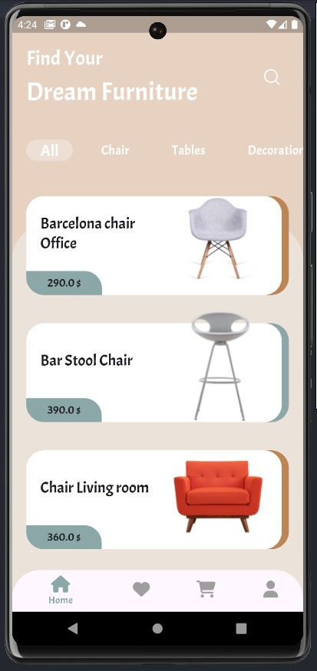
Categorized Product Browsing
Easy access to categories like Decoration, Chairs, and Tables

Slide 11
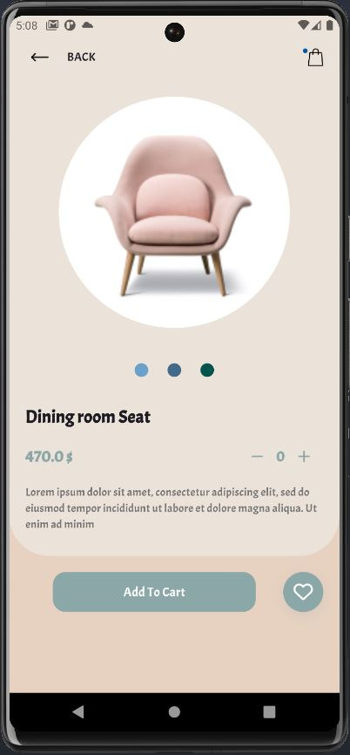
Detailed Product Information
Comprehensive descriptions and prices for each item

Slide 12
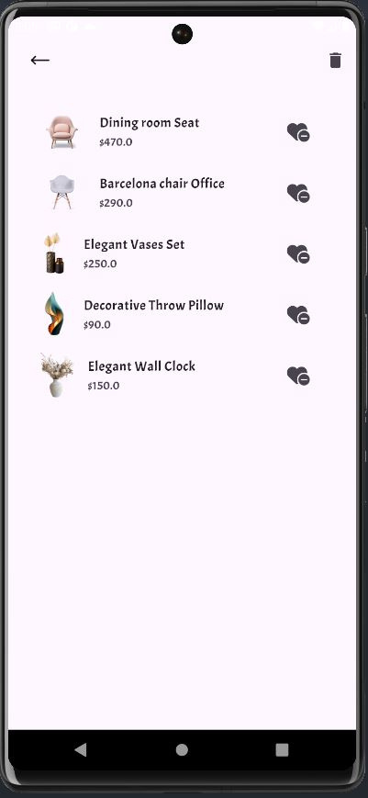
Favorites Feature
Save desired products for future reference

Slide 13
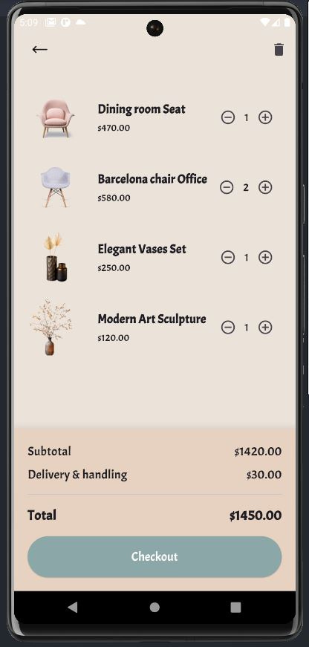
Shopping Cart
Conveniently manage selected items and adjust quantities

Slide 14
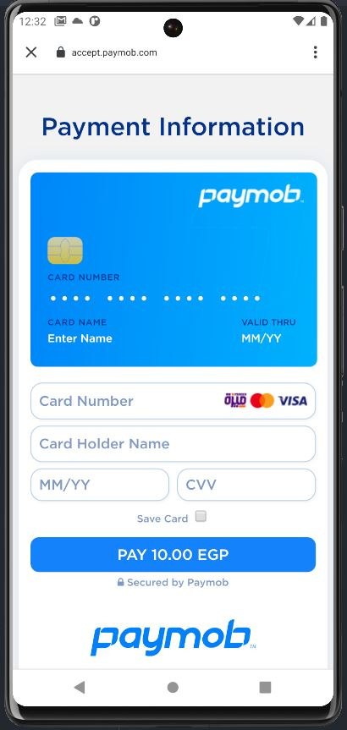
Seamless Checkout Process
Quick and easy payment options for a smooth shopping experience.

Slide 15
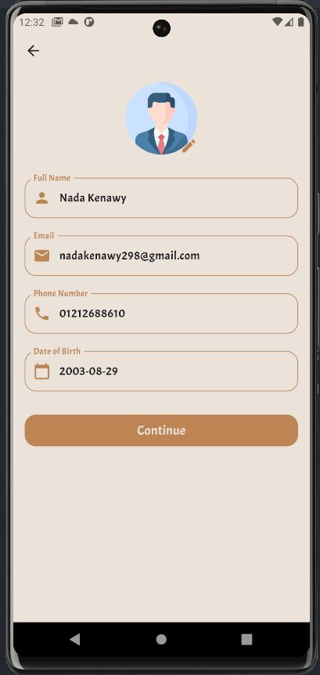
Profile Page
Users can input personal information, update their profile, and add a profile picture for a personalized experience.

Slide 16
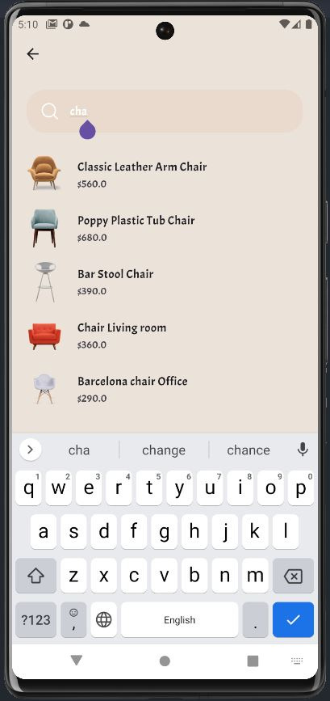
Search Functionality
Find products instantly by name

Slide 17

Marketing
Social Media Marketing
Paid Advertising
Content Marketing
Partnerships & Collaborations
Local Marketing
Customer Reviews
Discounts, Offers, and Flash Sales

Slide 18
Target Market
Young Professionals: Individuals aged 25-35 who value convenience and are comfortable with technology and online shopping.
Students: College students seeking affordable and functional furniture for their living spaces.
Urban Renters: People living in cities who often need space-saving furniture and prefer online shopping for quick solutions.
Tech-Savvy Consumers: Users who actively seek mobile apps for shopping and appreciate user-friendly interfaces and innovative features.
Home Decor Enthusiasts: Individuals interested in interior design who look for unique furniture pieces to enhance their living spaces.

Slide 19

How to develop.?
Order History:
Display past purchases in the user's profile
AR Feature:
Let users visualize furniture in their room using augmented reality.
Push Notifications:
Notify users of sales, offers, or cart reminders
Expand Categories:
add more categories like Sofas, Beds, Lighting, and Rugs to offer a wider variety of home furniture and decor options.
Enhancing Customer Reviews:
add star rating system, we’ll feature top reviews and offer incentives for feedback to boost trust and engagement.

Slide 20
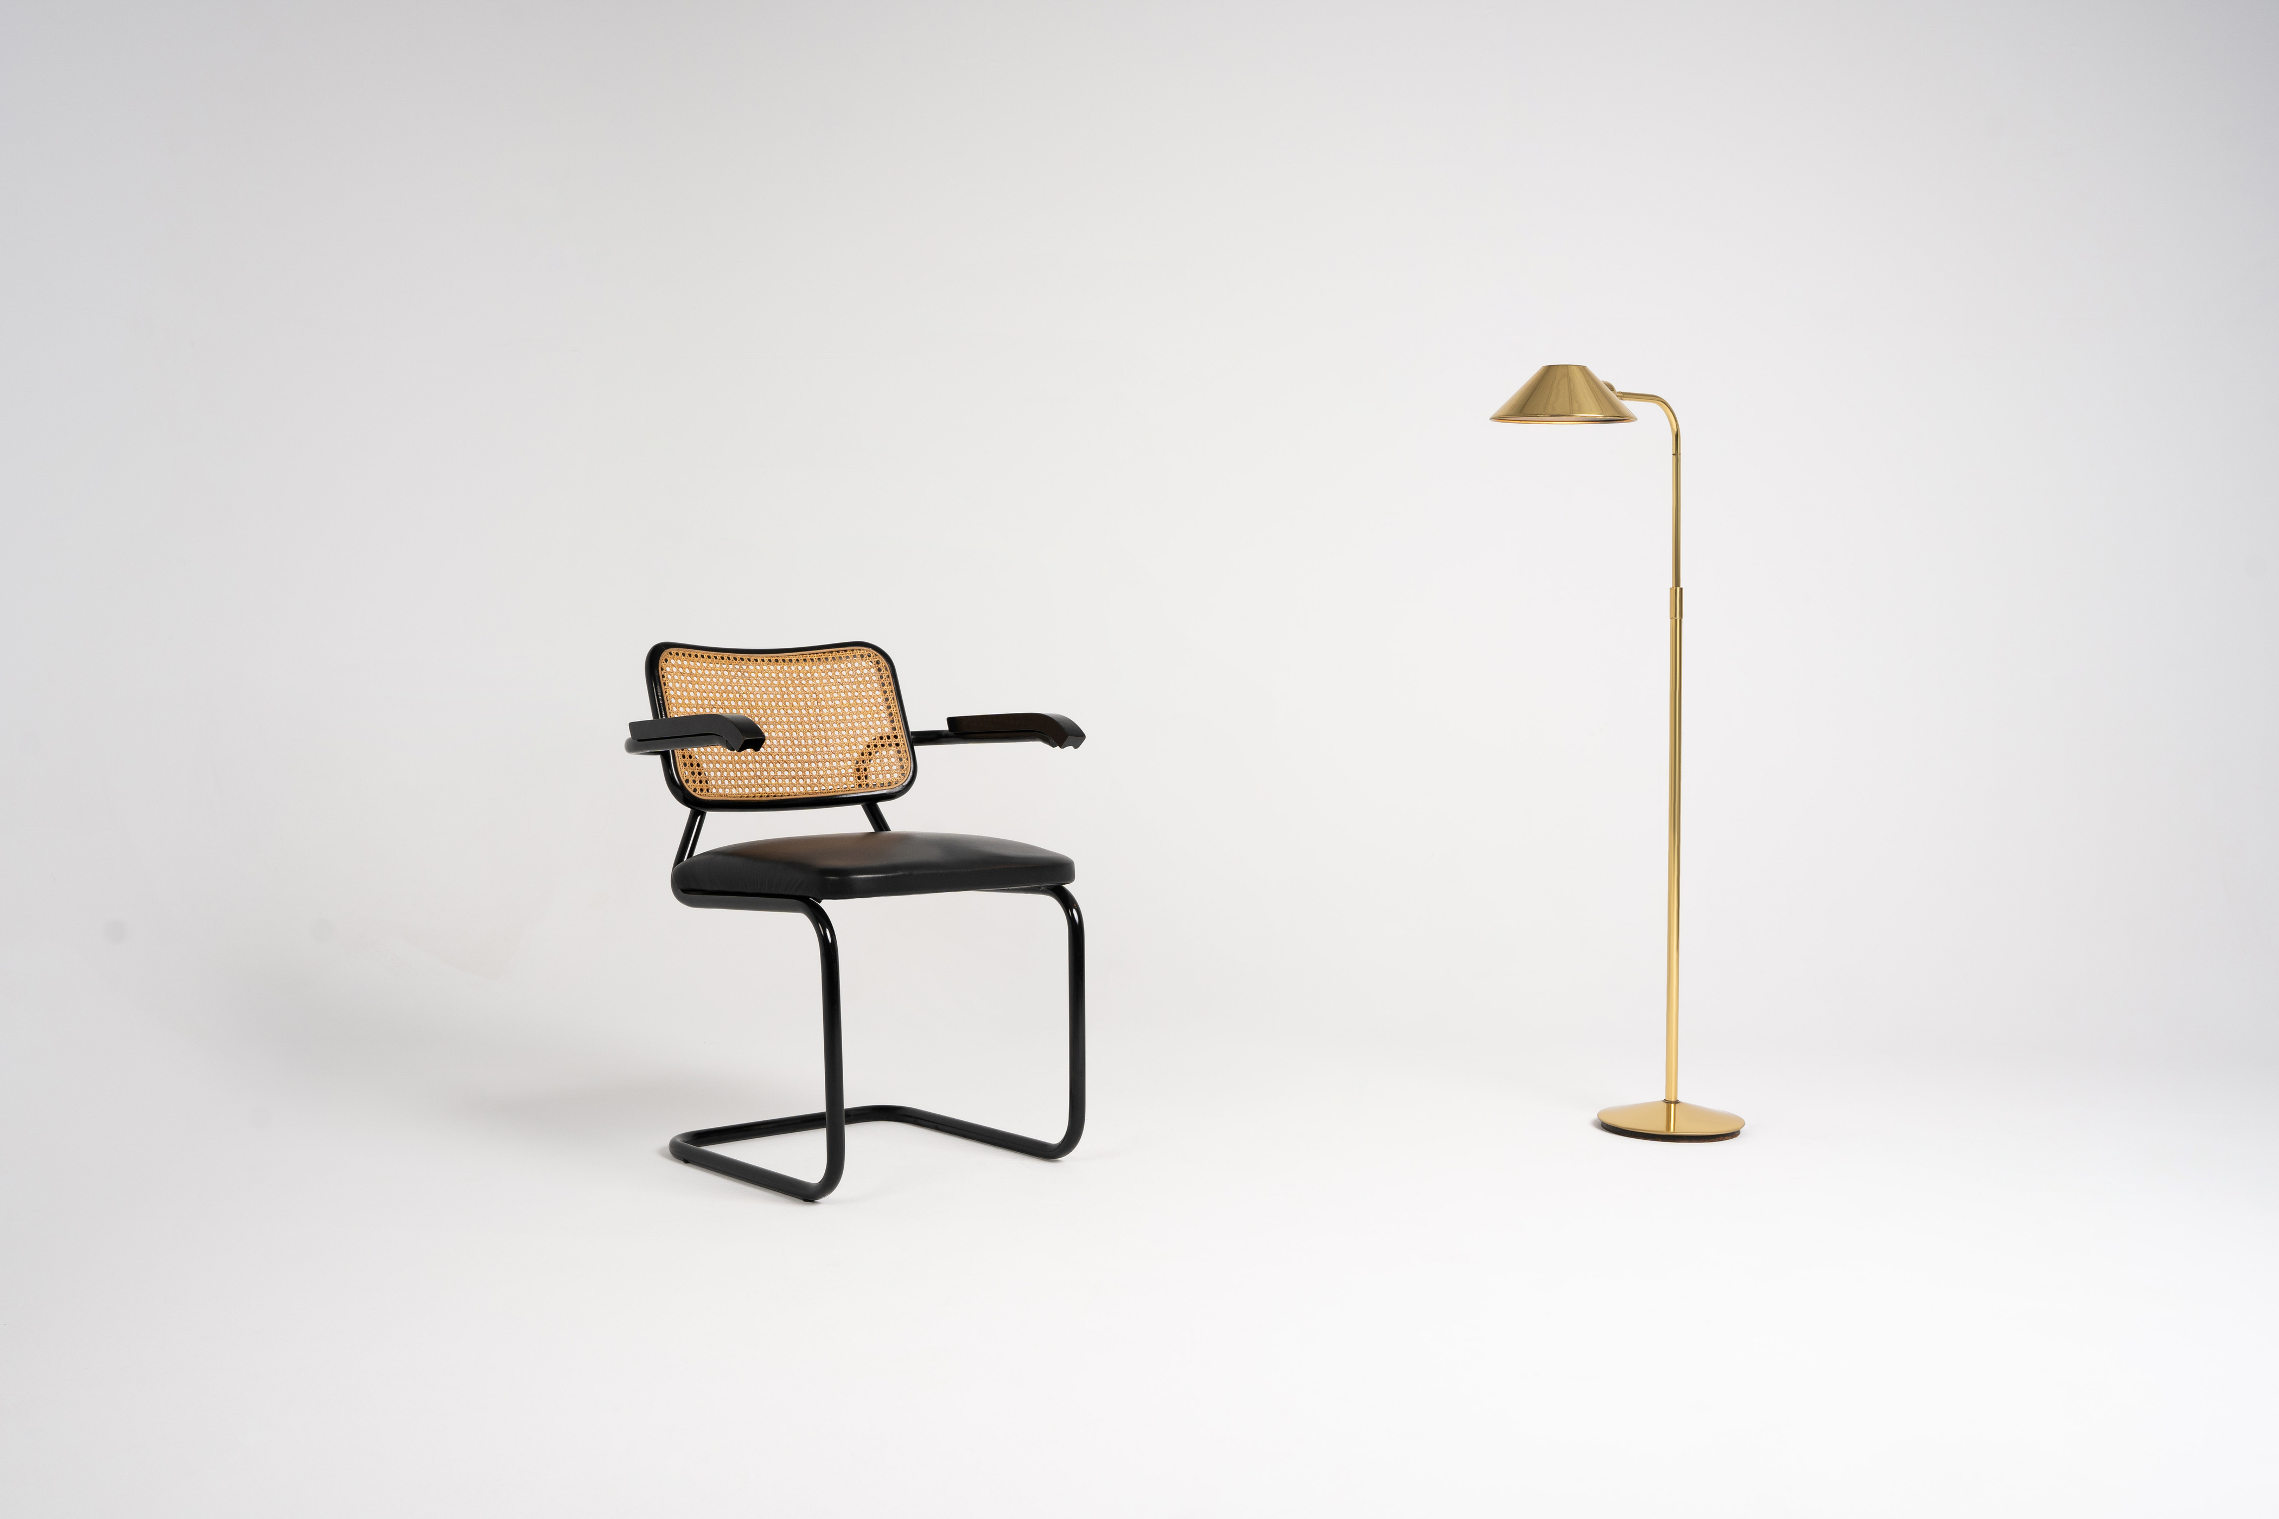
Thank you,

